Slide 1

Novel PVA Membranes Functionalized with L-Arginine for dual Virus and Carbon capture
Salma Ly
Pi: Dr. Matthew Green
School for Engineering of Matter, Transport and Energy
Arizona State University

Slide 2
Research Question/Motivation
Space Technology Mission Directorate (STMD):
Tackling the CO2 challenge
- Technology Research & Development Challenges
Human Exploration & Operations Missions Directorate (HEOMD):
Mitigating human health risk, creating safe and reliable environment
Engineering research
Physical Research
Research Questions:
Can electrospinning a nanofibrous non-woven poly(vinyl) alcohol mat functionalized with L-Arginine synthesize a reusable practical mask that protects from a variety of viruses?
Can electrospinning a nanofibrous non-woven poly(vinyl) alcohol mat functionalized with L-Arginine synthesize a reusable filter for carbon capture?

Slide 3
Overview w
Background on question/goals
Background on techniques/procedures
Results – Virus Capture
Results – carbon capture
Discussion
Future problems
Acknowledgment
References

Slide 4
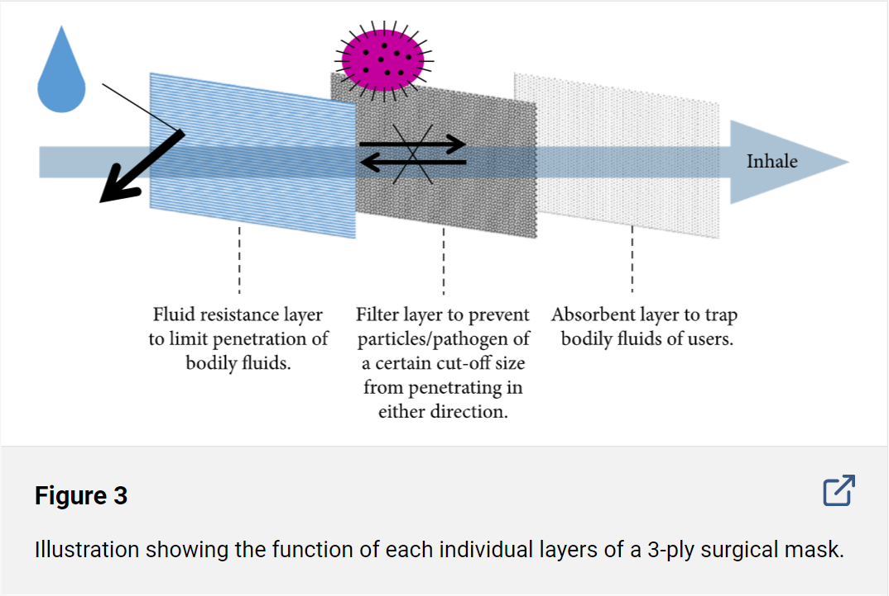
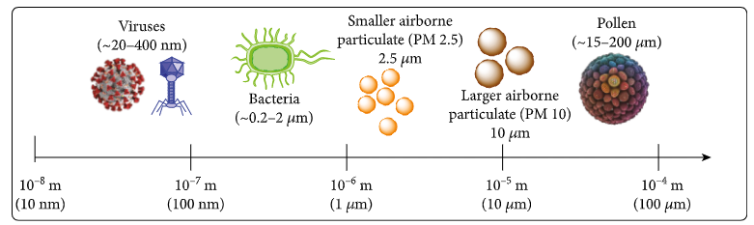
Background- Existing masks
Homemade mask:(Two or more layers of washable breathable fabric): lowest results in terms of filtration of airborne particles
N95 :(polypropylene & spun bonding)
Surgical mask: best against airborne particles, disposable
Exhalation valves or vents: ( is not effective and does not prevent virus particles from entering)
Gaiters: (needed two or more layers to become an effective filter)
Face shields:(does not prevent particles from entering, no filtration
Notes:
Spun bonding: uses nozzles blowing melted threads of a thermoplastic polymer (often polypropylene) to layer threads between 15-35 micrometers on a conveyor belt, which build up into cloth as the belt continues down the line

Slide 5
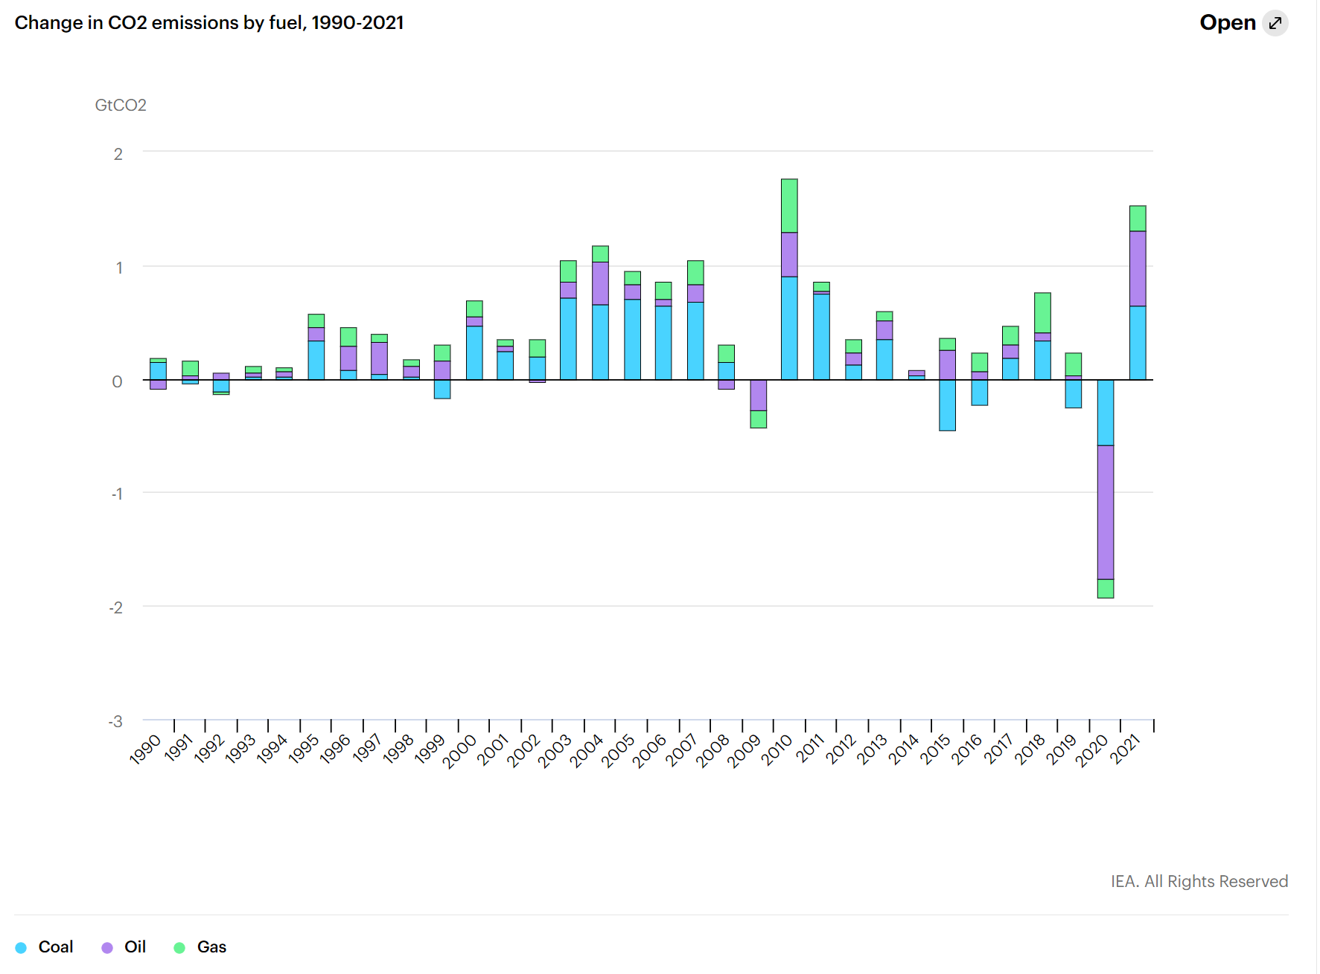
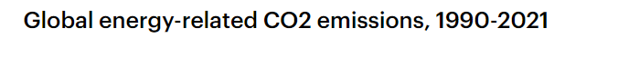
Background-Carbon Capture/ Global warming
What is Global warming and climate change
2021-22 carbon Emissions:
IEA, Change in CO2 emissions by fuel, 1990-2021, IEA, Paris https://www.iea.org/data-and-statistics/charts/change-in-co2-emissions-by-fuel-1990-2021
IEA, Global energy-related CO2 emissions, 1990-2021, IEA, Paris https://www.iea.org/data-and-statistics/charts/global-energy-related-co2-emissions-1990-2021
Notes:
Spun bonding: uses nozzles blowing melted threads of a thermoplastic polymer (often polypropylene) to layer threads between 15-35 micrometers on a conveyor belt, which build up into cloth as the belt continues down the line

Slide 6
Overview w
Background on question/goals
Background on techniques/procedures
Results – Virus Capture
Results – carbon capture
Discussion
Future problems
Acknowledgment
References

Slide 7
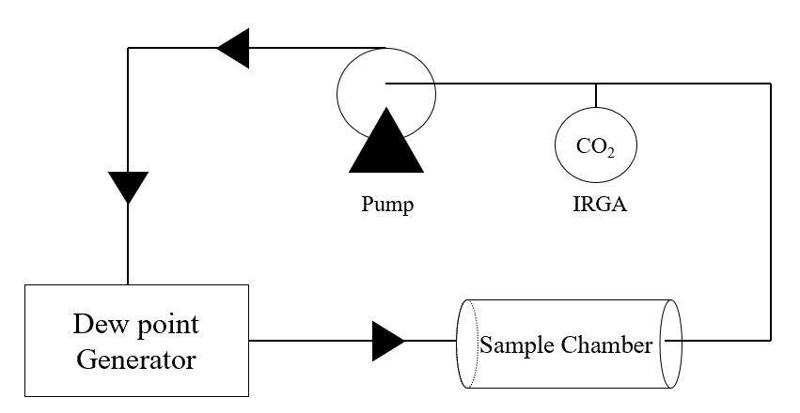
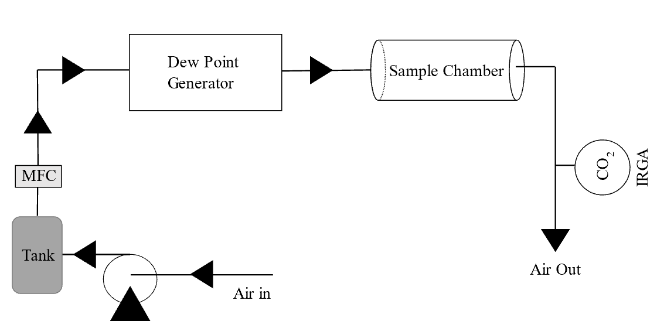
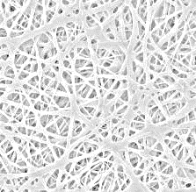
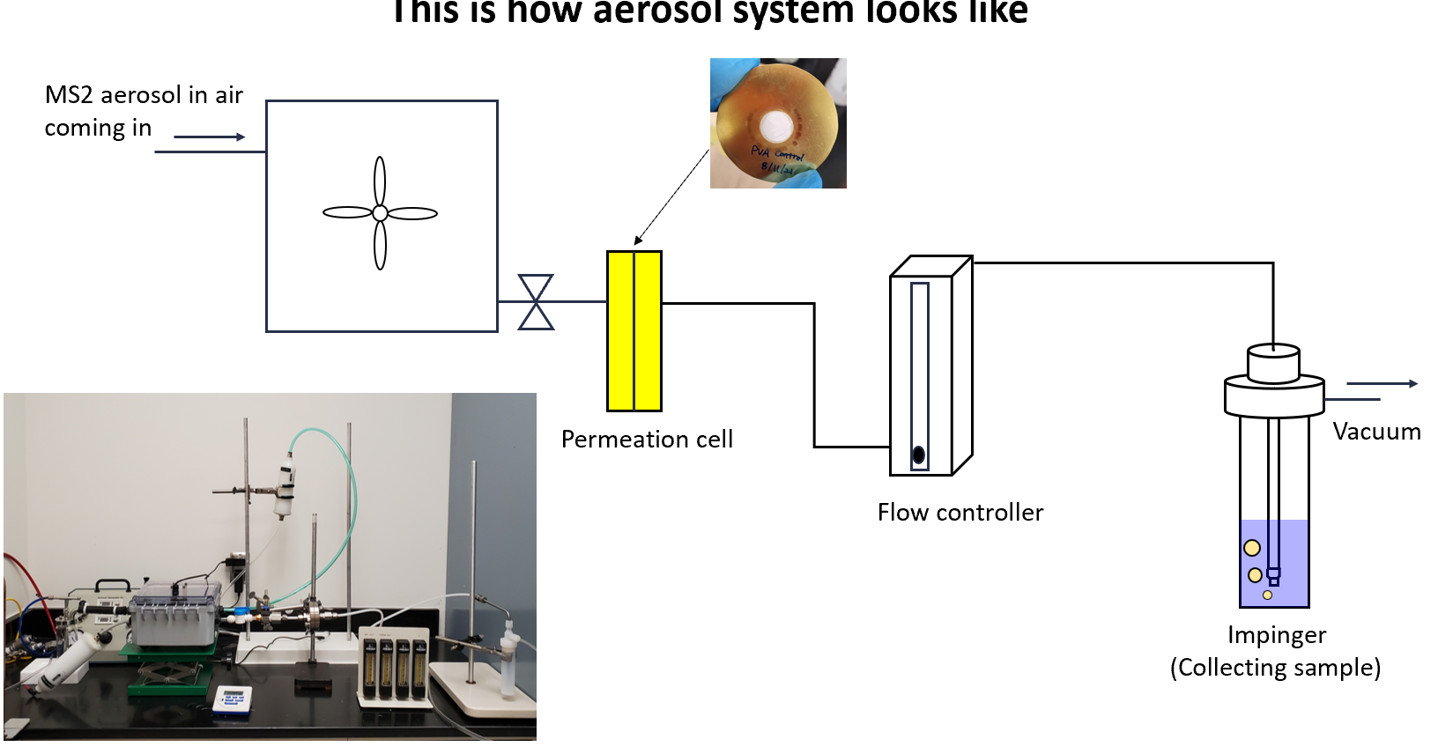
Background- Techniques used
Polymer Synthesis:
Testing apparatuses used:
Electrospinning:
- Variables to change concentrations, needle distance, voltage, flow rate
Direct Air Capture (DAC):
Closed circuit
High voltage DC
power supply
V
Direct Air Capture (DAC):
Open circuit
Needle
Jet
Syringe
Virus Capture testing:
+
+
+
+
+
Syringe pump
+
+
+
Taylor cone
PVG + DI water

Slide 8
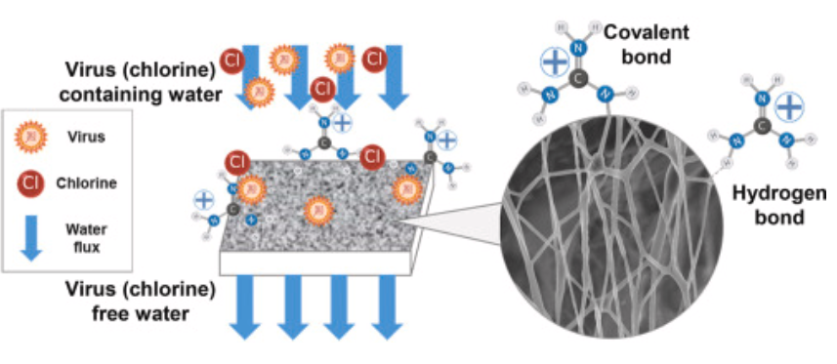
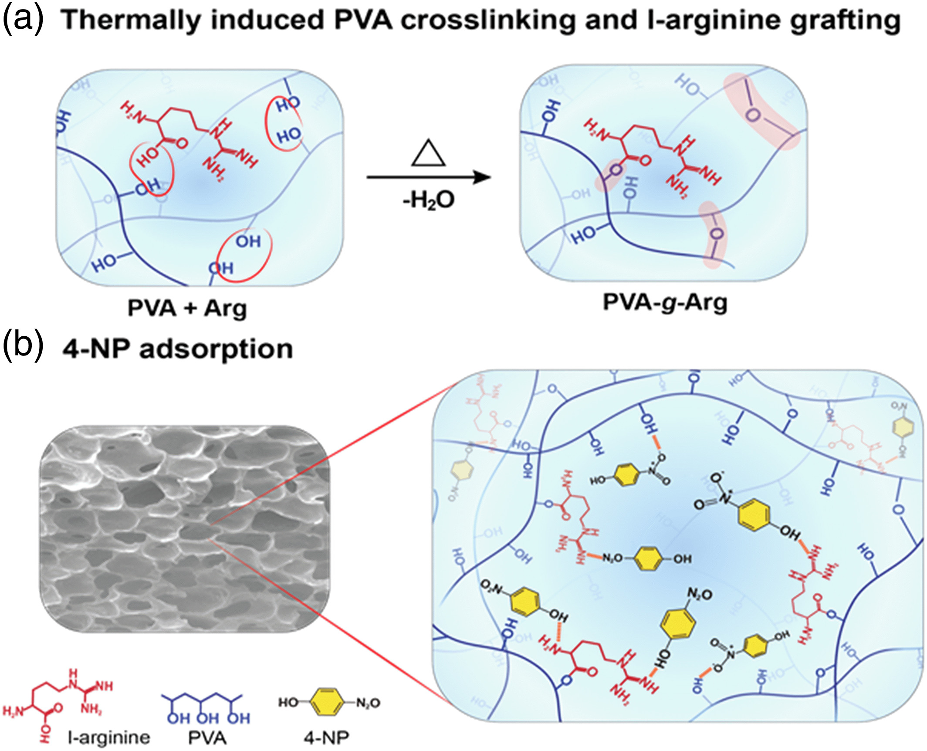
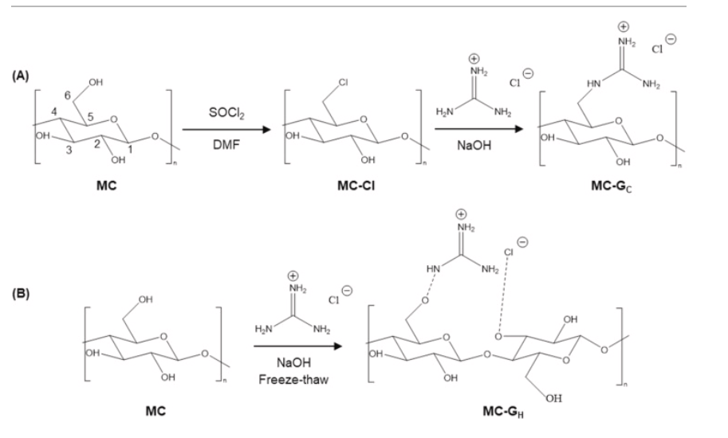
Background-Chemical Reactions Virus Capture
Capture of virus (charged particles)
Washing out the virus
Attaching L-arginine to PVA
Crosslinking with citric acid
Notes:
Dehydration synthesis

Slide 9
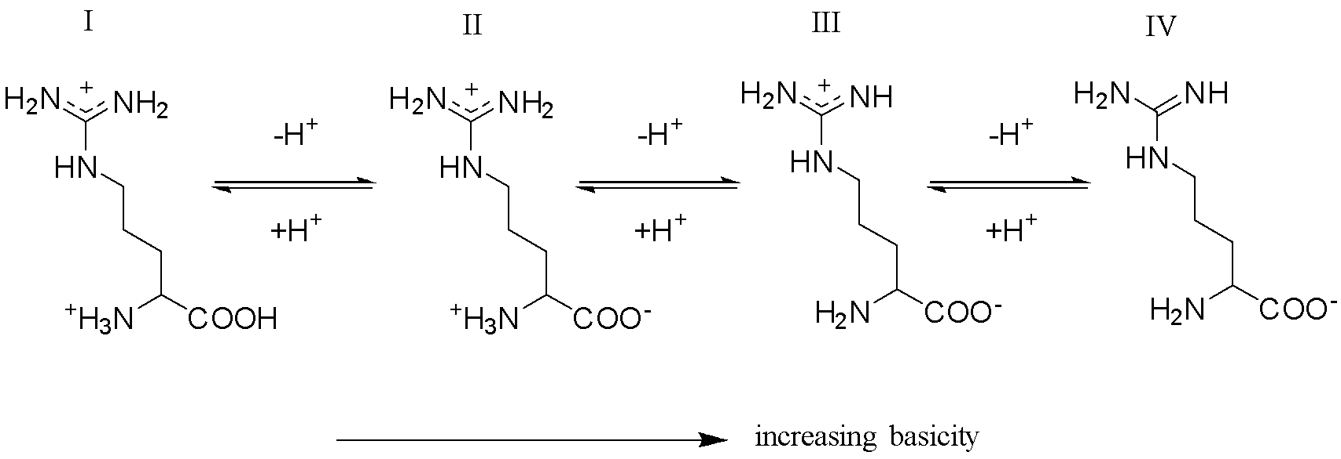
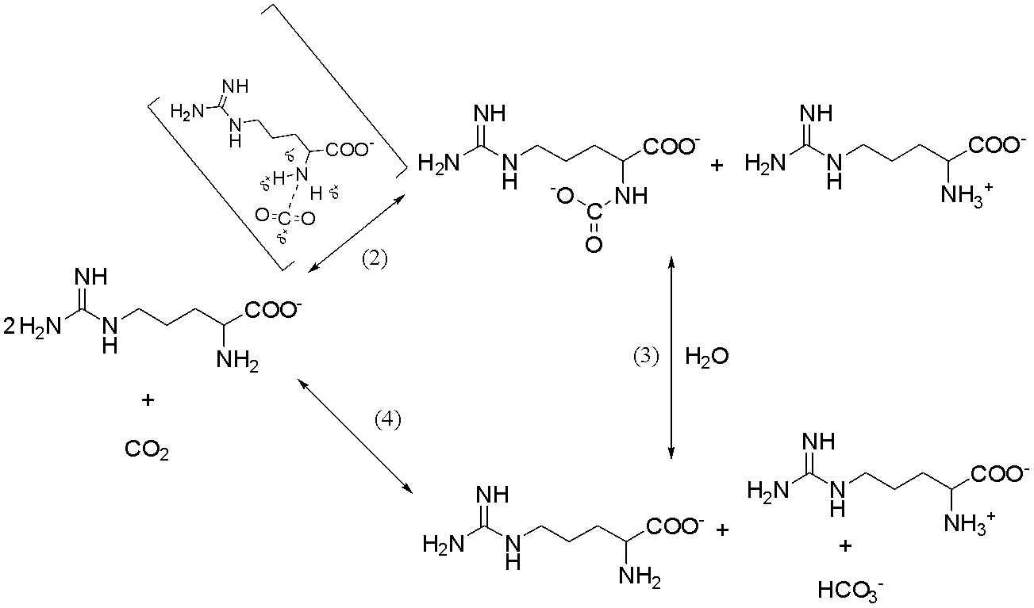

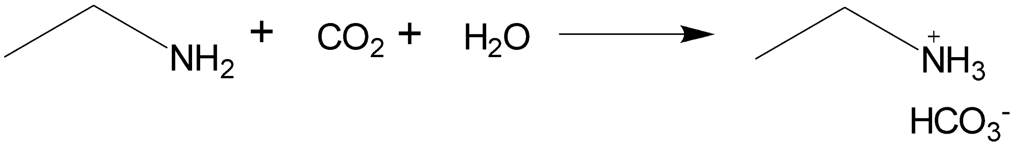
Background-Chemical Reactions CO2 Capture
- General Goal Reaction:
- Amine Functionlized polymer CO2 capture mechanism
Possible mechanisms of sorption of amines:
Zwitterionic
termolecular
L-Arg at different pH
Zwitterionic reaction mechanism
(0.5:1 CO₂: sorbent stoichiometry)
(Guanidine group can abstract the hydrogen from intermediate leading to 1:1 stoichiometry)

Slide 10
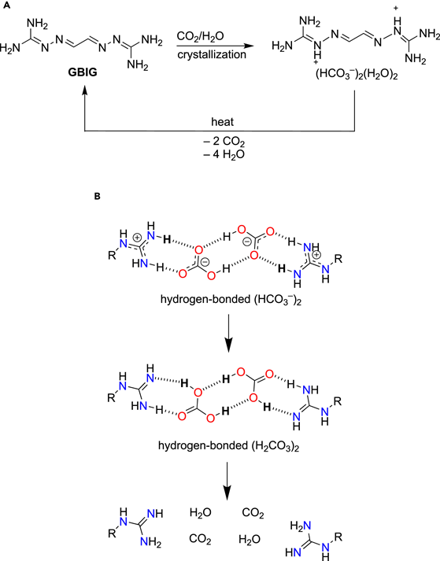
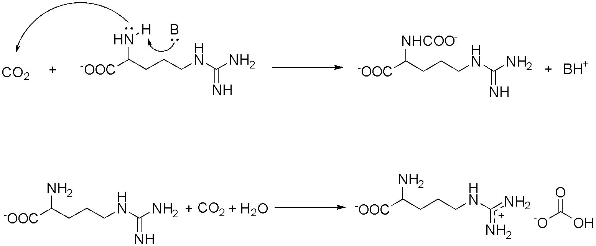
Background-Chemical Reactions CO2 Capture
- General Goal Reaction:
- Amine Functionlized polymer CO2 capture mechanism
Mechanisms of sorption of amines:
Zwitterionic
Termolecular
Termolecular reaction mechanism (1:1)
Bicarbonate formation on reaction with guanidine group of L-Arg (1:1)
N. J. Williams et. al, Chem 2019, 5, 719.

Slide 11
Overview w
Background on question/goals
Background on techniques/procedures
Results – Virus Capture
Results – carbon capture
Discussion
Future problems
Acknowledgment
References

Slide 12
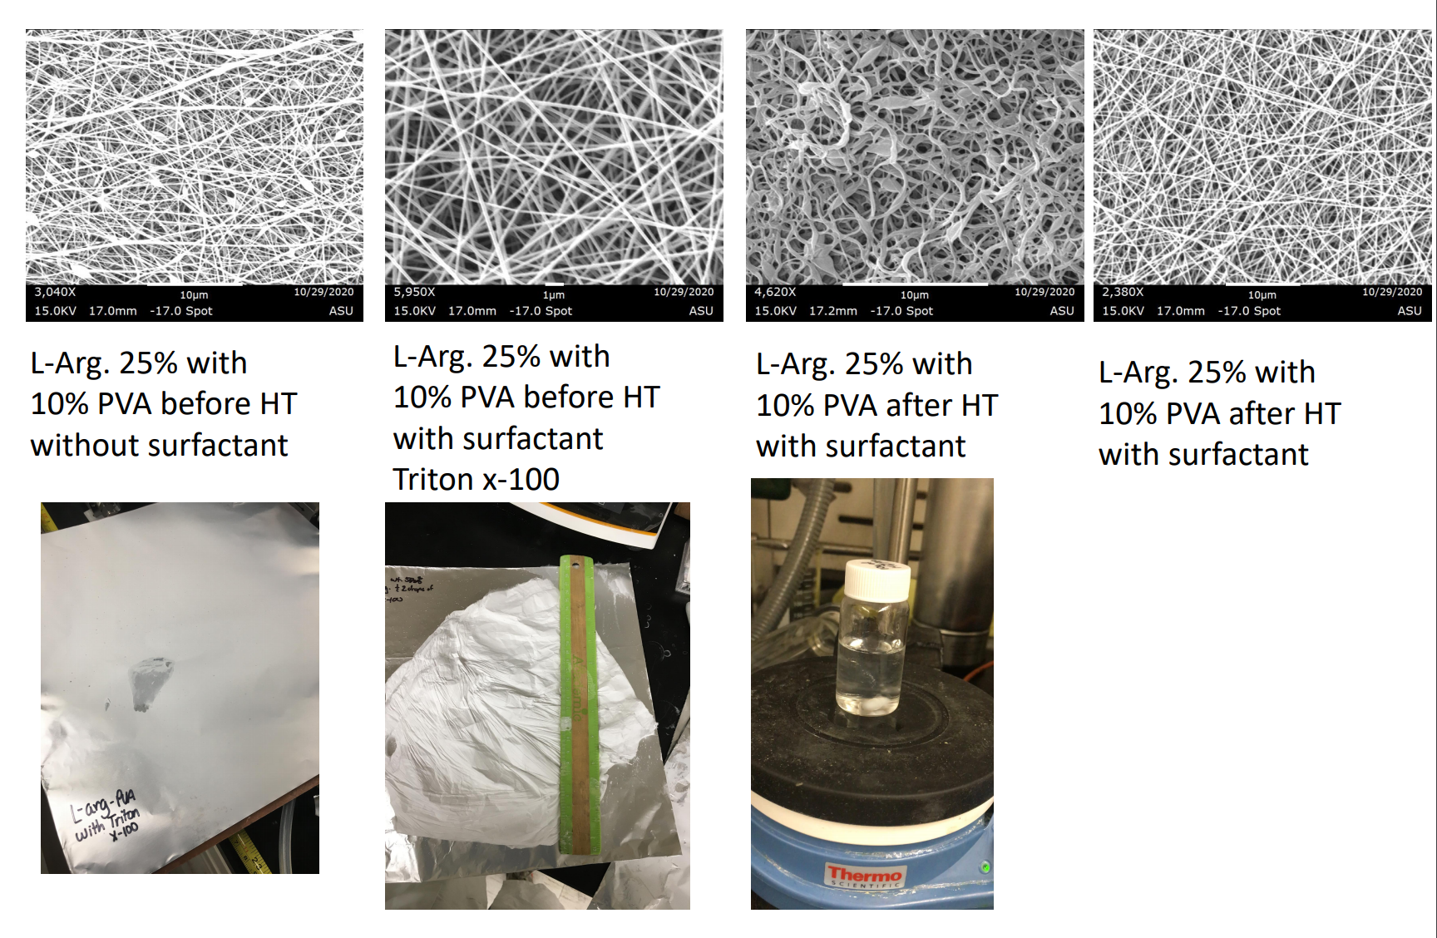
Polymer Parameters

Slide 13
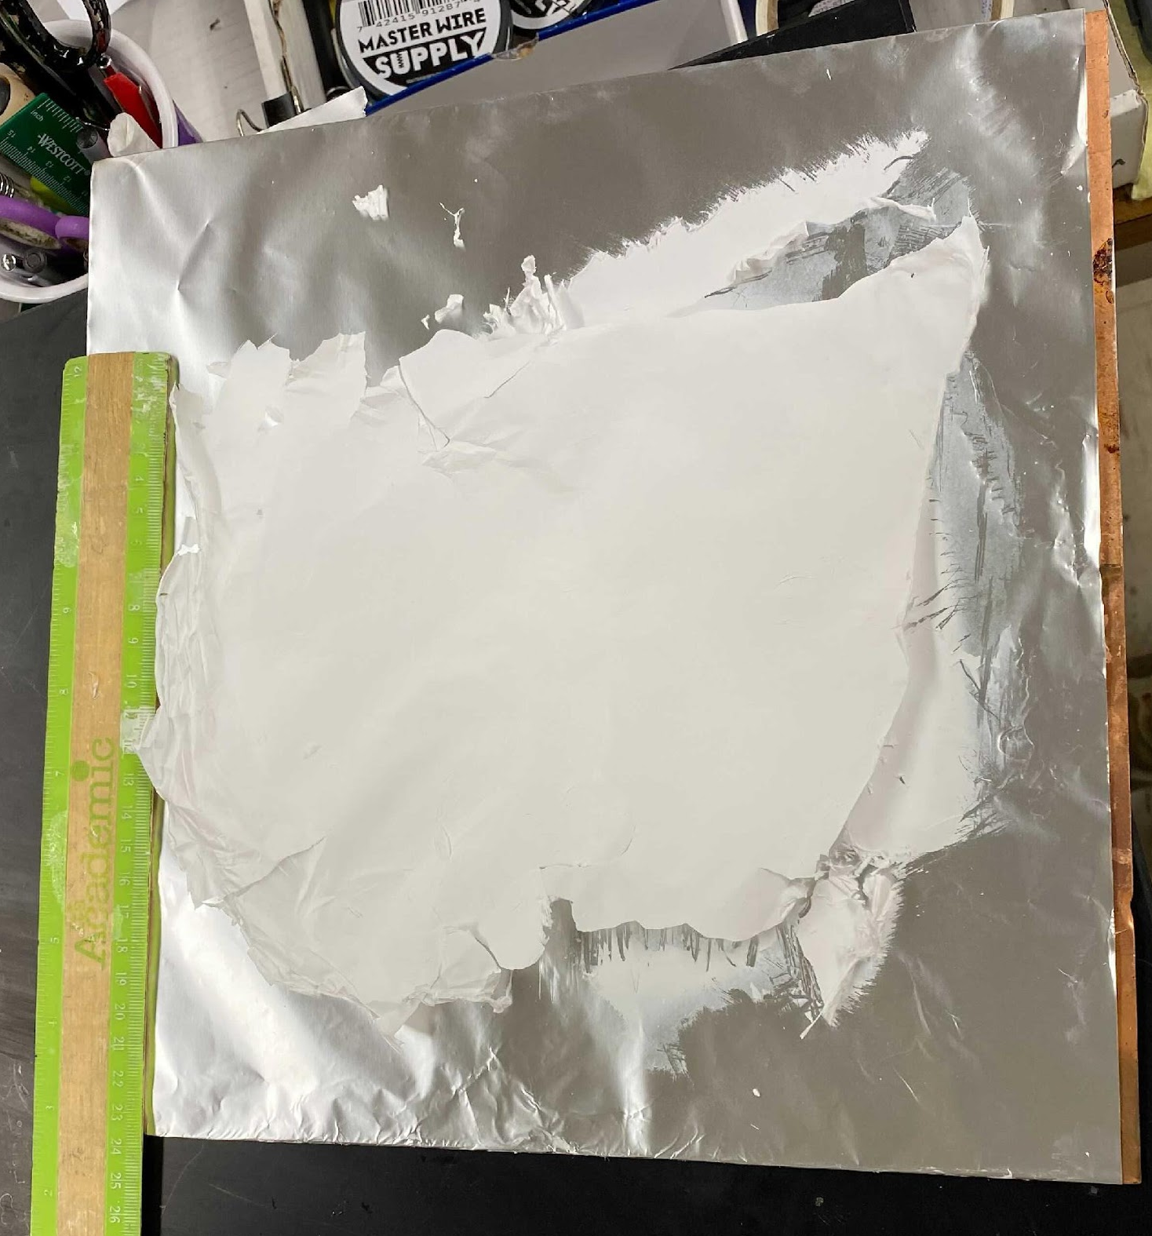
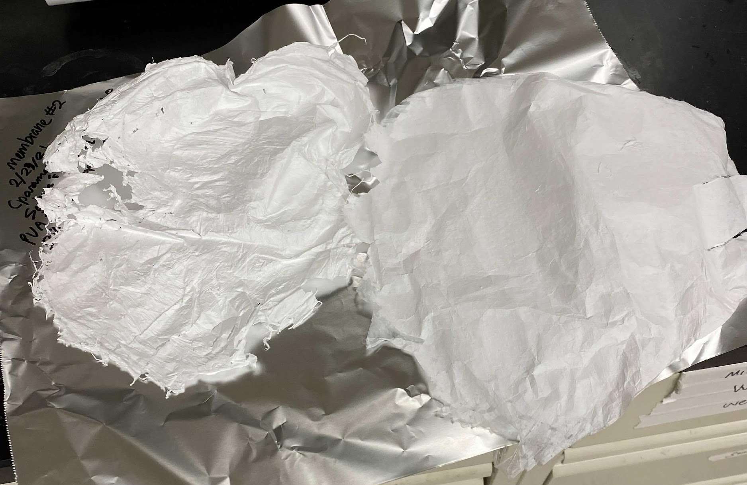
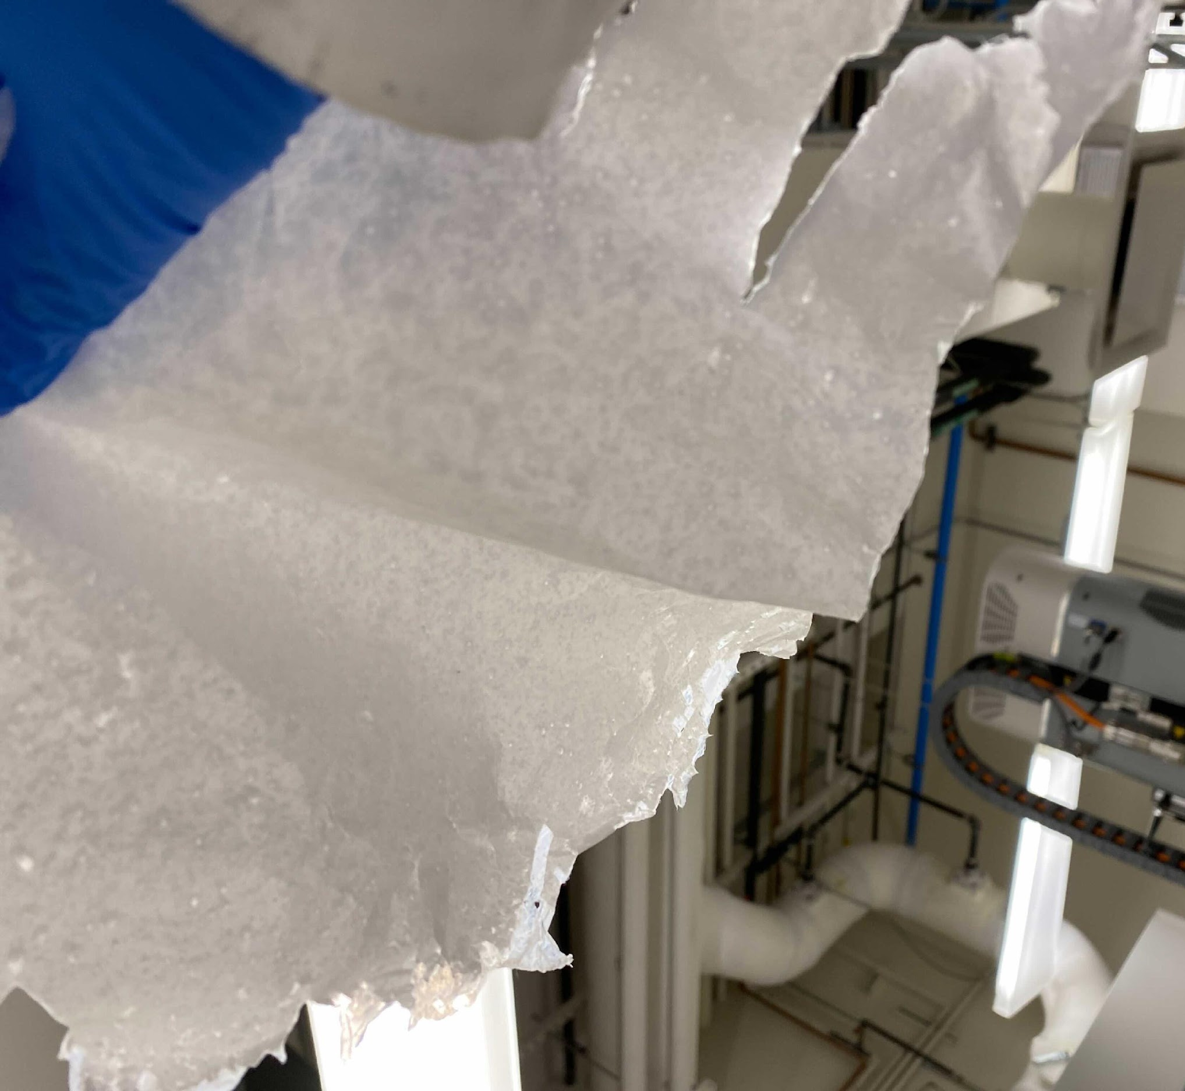
Polymer Samples
Polymer Characteristics/ Improvements:
- Amount of solution used to determine average size reproduced vs goal size
14% PVA mats spun with better fibers
Larger sample size to work with
increased concentrations of L-Arginine
Porous structure was checked by holding peeled mat to the light
(Manual: Korah, M. M., Ly, S., Barbosa, T., Lackner, K. S., & Green, M. D. (n.d.). Electrospun poly(vinyl alcohol) - L-arginine nanofiber composites for direct air capture of CO2. Wiley-VCH. )

Slide 14
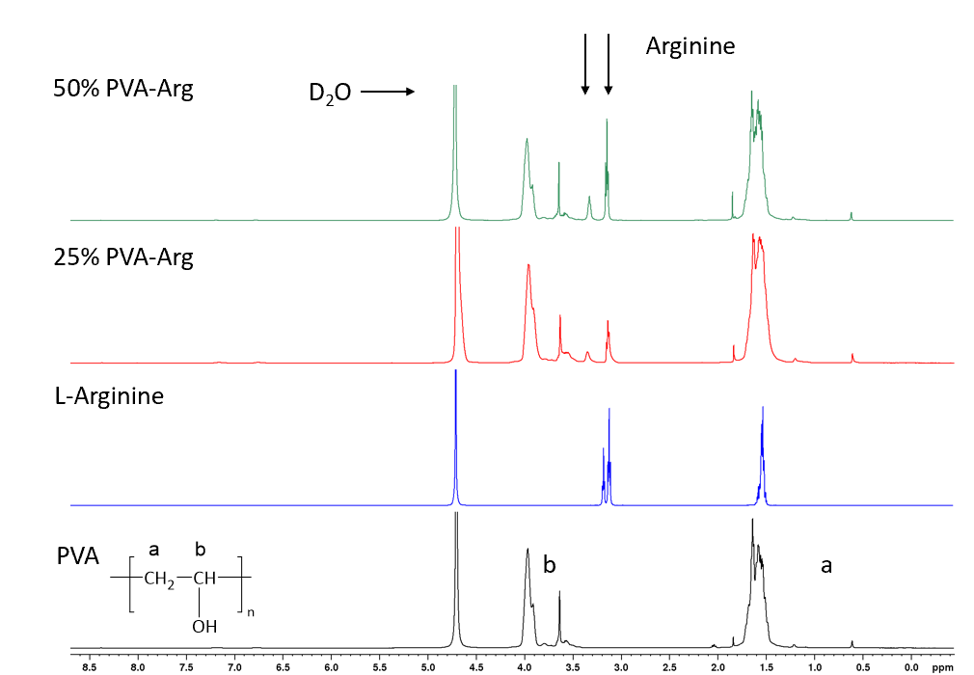
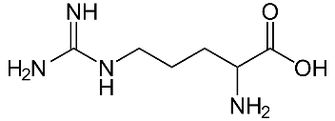
H-NMR Samples
L-Arginine

Slide 15
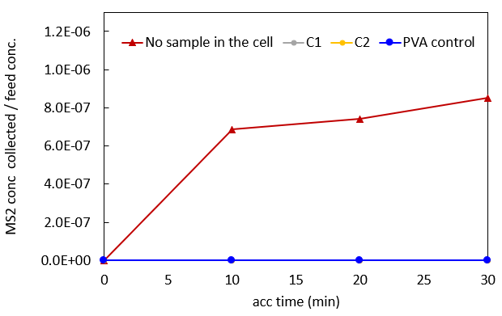
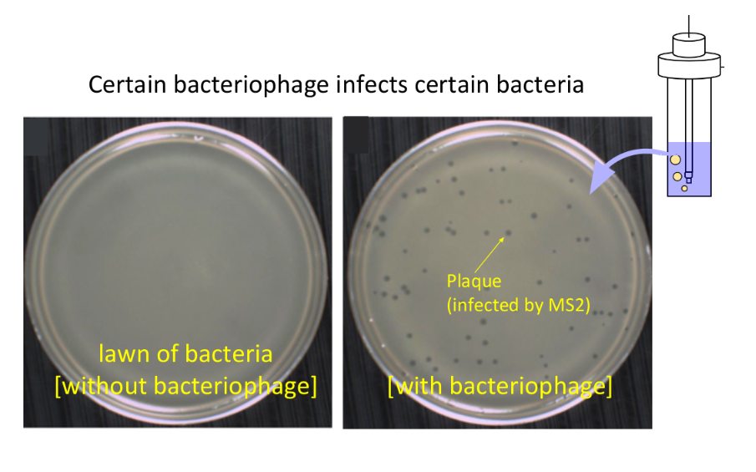
Results – UT Labs
Feed concentration = 6*10⁷ PFU/mL
MS2 collected when there is no sample inside the cell = 4.2*10¹, 4.5*10¹, 4.10¹ PFU/mL (10,20,30 min intervals)

Slide 16
Overview w
Background on question/goals
Background on techniques/procedures
Results/Discussion – Virus Capture
Results/Discussion – carbon capture
Future problems
Acknowledgment
References

Slide 17
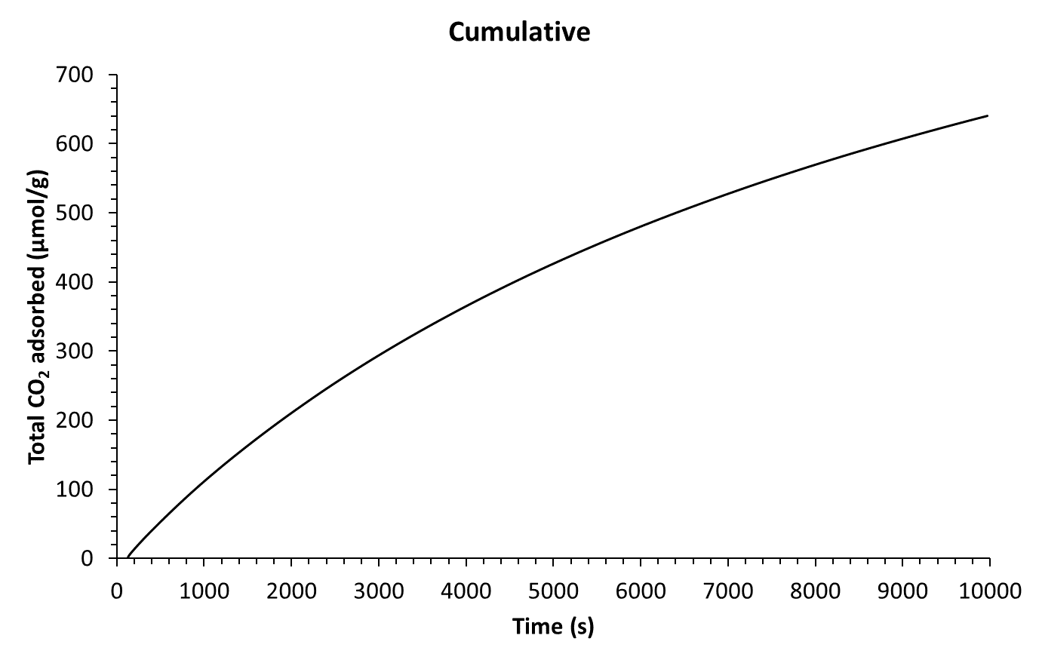
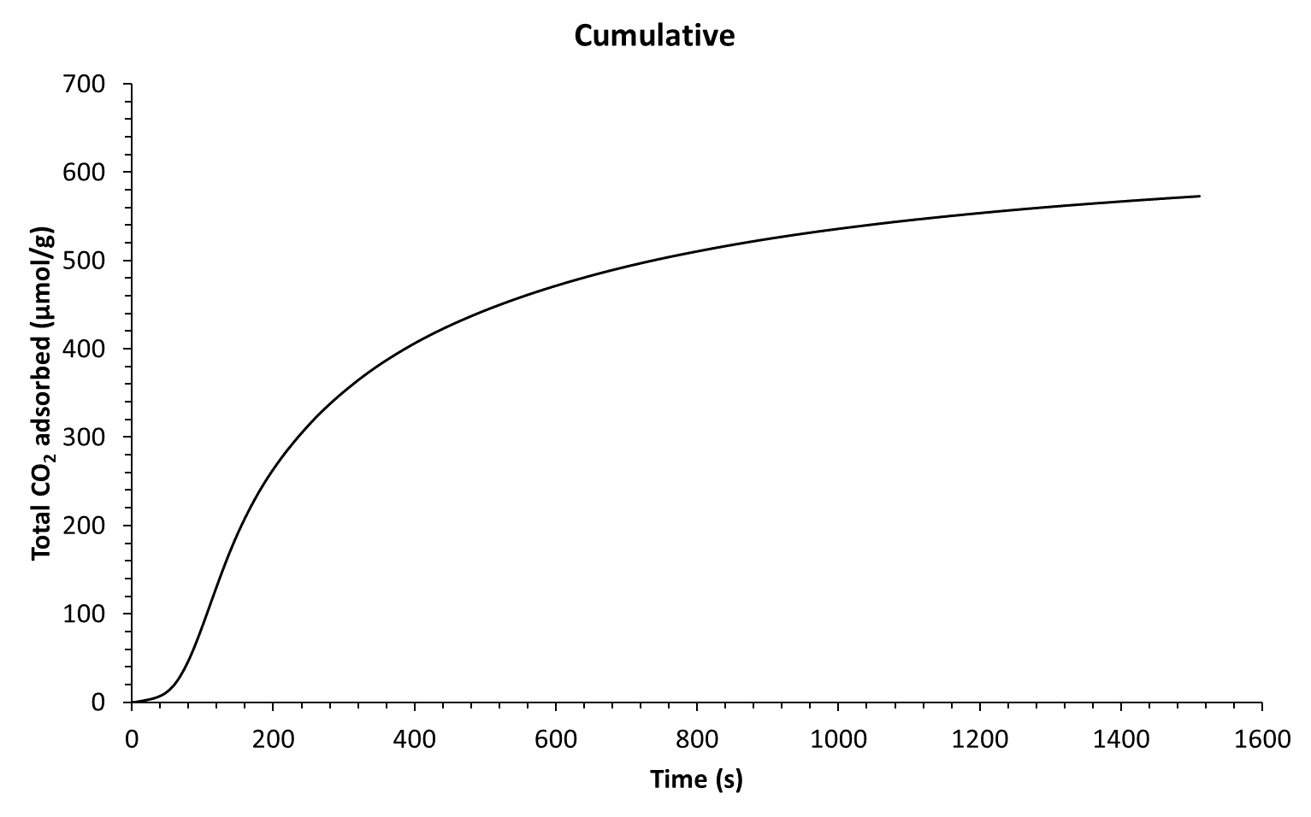
PVA L-Arginine Sorption Performance
Adsorption Performance
Desorption Performance
What does this mean in application?
  Mechanical tree use?
  Capacity for CO2
  Time and rate of adsorption
Cycle | Adsorption | Desorption
Q (µmol/g) | 542 | 579
Flux (µmol/g/s) | 0.063 | 0.318
Sample mass (g) | 0.51 | 0.51

Slide 18
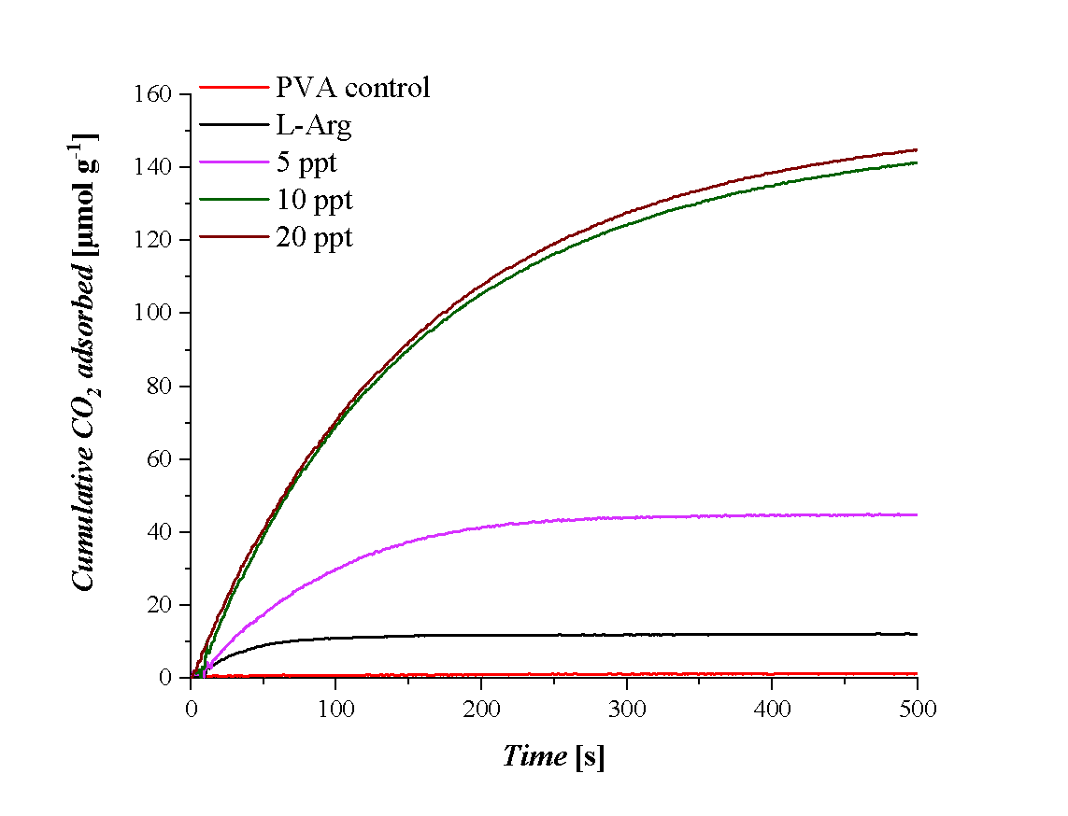
Results (Consideration of other factors )

Slide 19
Overview w
Background on question/goals
Background on techniques/procedures
Results/Discussion – Virus Capture
Results/Discussion – carbon capture
Future problems
Acknowledgment
References

Slide 20
Obstacles faced/ Over come
Improving efficiency on membrane through a higher concentration of guanine groups (instead of L-Arg.)
Crosslinking reagent concentrations (like glutaraldehyde)
Further improvement of chemical bond between amine groups and the polymer backbone
Overall mechanical properties of fiber strength to improve?
Further investigation in commercializing and longevity of material

Slide 21
Overview w
Background on question/goals
Background on techniques/procedures
Results/Discussion – Virus Capture
Results/Discussion – carbon capture
Future problems
Acknowledgment
References

Slide 22
Acknowledgements
Associate Professor Green
PhD student Mani Korah
Green Research Group
UT Lab from the Department of Chemical Engineering (Hyeonji Oh, Charan Samineni, Sophie De Respino)

Slide 23
Overview w
Background on question/goals
Background on techniques/procedures
Results/Discussion – Virus Capture
Results/Discussion – carbon capture
Future problems
Acknowledgment
References

Slide 24
References
- Korah, M. M., Ly, S., Barbosa, T., Lackner, K. S., & Green, M. D. (n.d.). Electrospun poly(vinyl alcohol) - L-arginine nanofiber composites for direct air capture of CO2. Wiley-VCH.
-Shi, Qing, et al. Grafting Short-Chain Amino Acids onto Membrane Surfaces to Resist Protein Fouling, 13 Oct. 2010, pp. 1–7.
-Chen, Dandan, et al. Influence of L-Arginine on Performances of Polyamide Thin-Film Composite Reverse Osmosis Membranes, 15 June 2019, pp. 1–12.
-Venturi, Davide, et al. Arginine/Nanocellulose Membranes for Carbon Capture Applications, 10 June 2019, pp. 1–17.
-Hussein, Yasmein, et al. “Electrospun PVA/Hyaluronic Acid/L-Arginine Nanofibers for Wound Healing Applications: Nanofibers Optimization and in Vitro Bioevaluation.” International Journal of Biological Macromolecules, vol. 164, 11 July 2020, pp. 667–676., doi:10.1016/j.ijbiomac.2020.07.126.
-Sapalidis, Andreas A. Porous Polyvinyl Alcohol Membranes: Preparation Methods and Applications, 5 June 2020, pp. 2–22.

Slide 25
Thank you

